Slide 1
CompTIA A+ Certification 801 Support Skills
Unit 1.4 Connection Interfaces

Slide 2
Describe the functions and capabilities of connection interfaces (USB, SCSI, Firewire, Serial, Parallel, VGA, DVI, HDMI, and Audio)
Identify the types of cables and connectors used with connection interfaces
Unit 1.4 Connection Interfaces
Slide <number>

Slide 3
Signaling
Using electrical signals to exchange information between components and networks
Serial
  Single-ended
  Differential
Parallel
Frequency (MHz / GHz)
Digital / analog
Unit 1.4 Connection Interfaces
Slide <number>

Slide 4
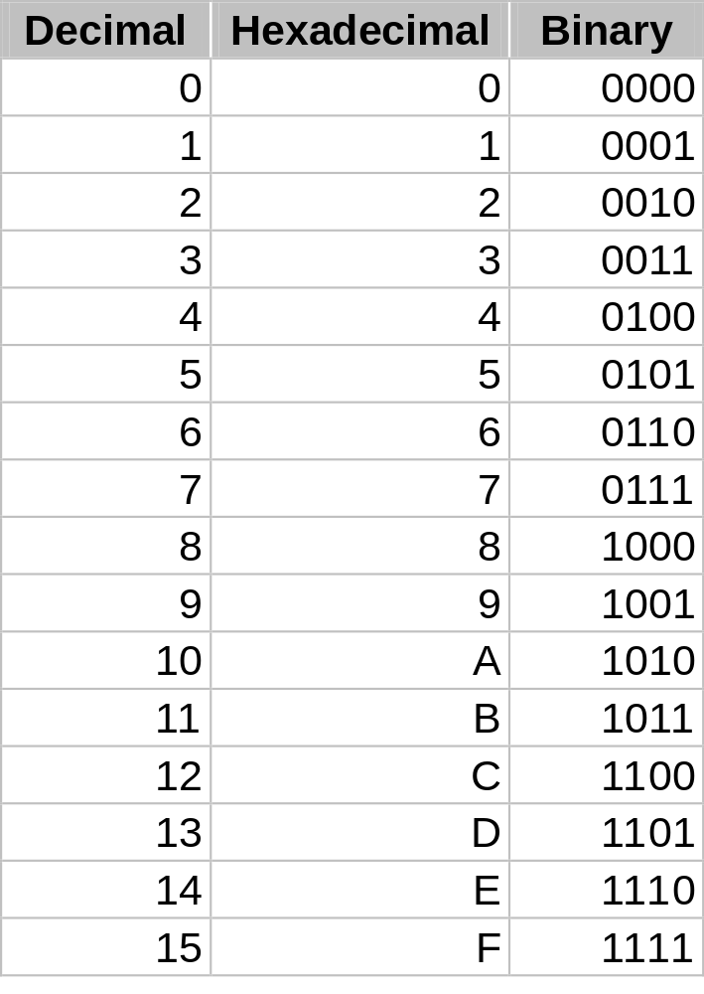
Data Units, Binary, Hex
bits, Bytes, mega, and giga
Decimal notation (Base 10)
Binary notation (Base 2)
Hexadecimal notation (Base 16)
Unit 1.4 Connection Interfaces
Slide <number>

Slide 5
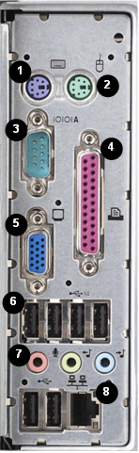
External Ports
PS/2 Keyboard (Purple)
PS/2 Mouse (Green)
Serial (Turquoise)
Parallel (Burgundy)
Monitor (Blue)
USB
Audio Microphone In (Pink), Audio Line Out (Lime), and Audio Line In (Light Blue)
Network (JR-45)
Joystick/MIDI (Gold) [not shown]
Unit 1.4 Connection Interfaces

Slide 6


PS/2 and Serial Ports
PS/2
  6-pin mini-DIN
  Mouse
  Keyboard
Serial (RS-232)
  Legacy port for modems and mice
  Null modem cable
  9-pin or 25-pin D-shell
  ~115 Kbps
  ~ 15m (50 feet) @ 9,600 bps
Unit 1.4 Connection Interfaces
Slide <number>

Slide 7

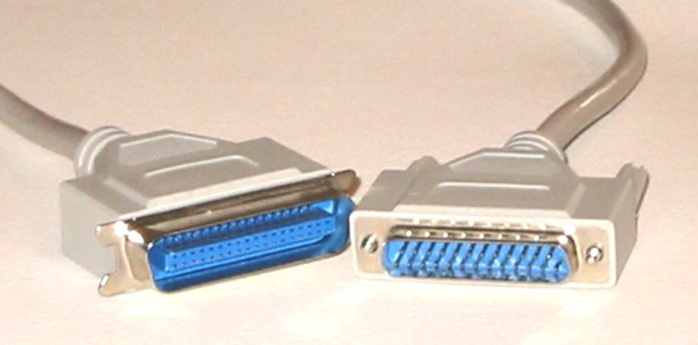
Parallel Ports
Printer / Centronics port
Modes
  Standard (~150 Kbps)
  4-bit
  8-bit (~150 Kbps bi-directional)
  ECP / EPP (~2 MBps)
25-pin DB host connector
36-pin device Centronics edge connector
Cable length
  Standard: ~5m (15 feet)
  IEEE1284: 10m (30 feet)
Unit 1.4 Connection Interfaces
Slide <number>

Slide 8
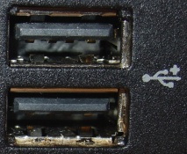
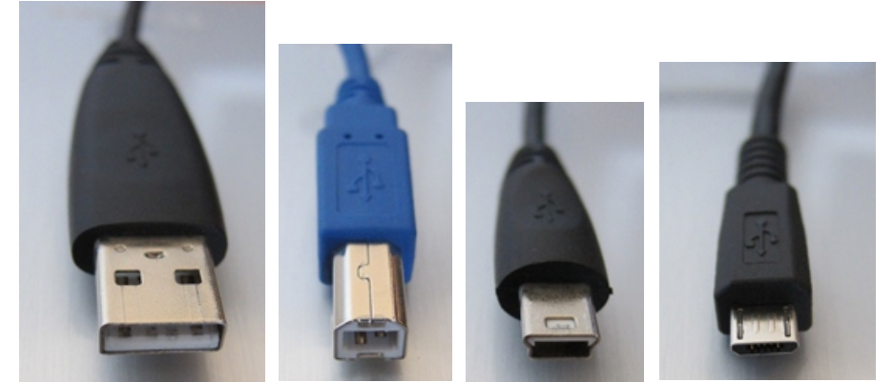
USB Ports
Powered (500mA / 900mA [v3]), serial bus
Hot swappable
Up to 127 devices / bus
Data rate
  12 Mbps (USB 1.1)
  480 Mbps (USB 2.0 / High Speed)
  4.8 Gbps full duplex (USB 3.0 / Super Speed)
Connectors
  Host / hub (Type A connector)
  Function / device (Type B connector)
  USB Mini
  USB Micro
  USB v3
5m (16.5 feet) cable length / ~3m for Super Speed
Unit 1.4 Connection Interfaces
Slide <number>

Slide 9
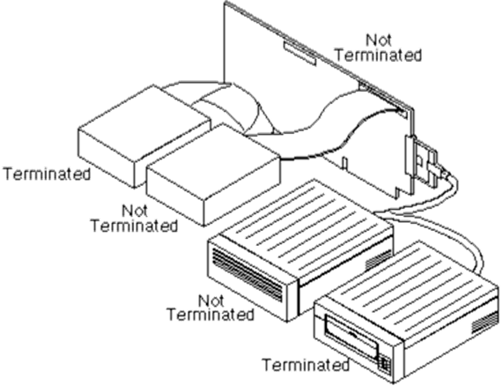
SCSI (Small Computer System Interface)
Unit 1.4 Connection Interfaces
Slide <number>

Slide 10
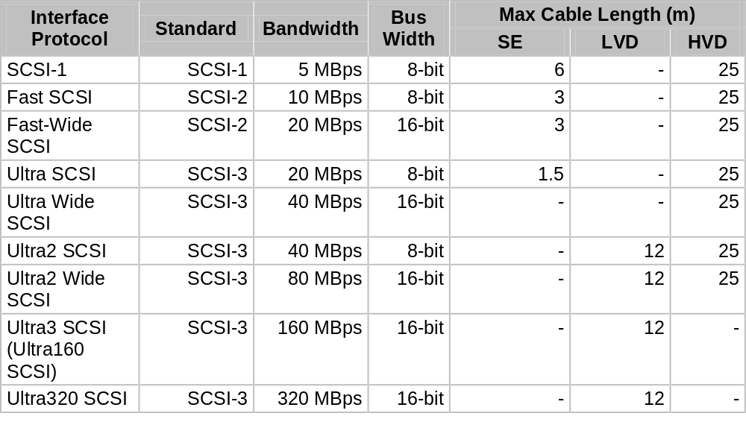
SCSI
Unit 1.4 Connection Interfaces
Slide <number>

Slide 11
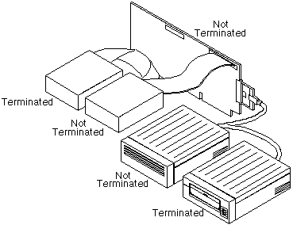
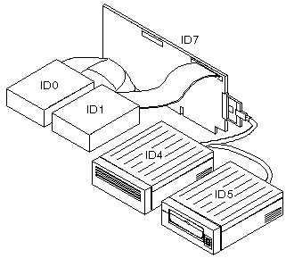
SCSI Configuration Issues
Host adapter
Bus width
Signaling
Termination
ID
Unit 1.4 Connection Interfaces
Slide <number>

Slide 12
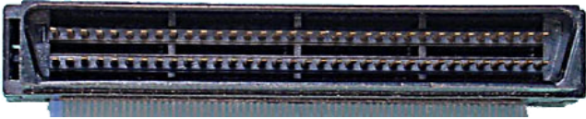

SCSI Connectors
IDC50 - a 50-pin internal connector used with early SCSI devices (SCSI-1)
CN50 - a 50-pin Centronics-style connector used for external connections in early SCSI devices
DB25 - a 25-pin connector used primarily by Apple and Iomega (Zip drives)
HD68 - 68-pin connectors used for internal and external ports. 68-pin adapters support Wide SCSI
Single Connector Attachment (SCA) - an 80-pin connector that incorporates both a power connector and configuration wires, allowing for hot swappable drives
Unit 1.4 Connection Interfaces
Slide <number>

Slide 13
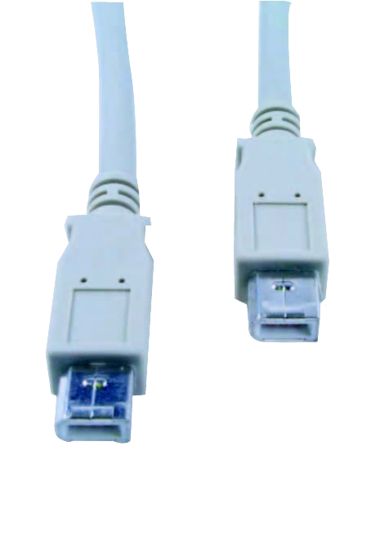
IEEE 1394 (Firewire)
Powered, serial bus
6-pin and 4-pin (unpowered) connectors
Hot swappable
Up to 63 devices / bus
4.5m (14.85 feet) cable length
400 Mbps or 800 Mbps (1394b)
Unit 1.4 Connection Interfaces
Slide <number>

Slide 14
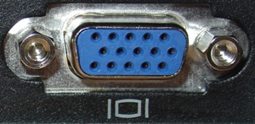
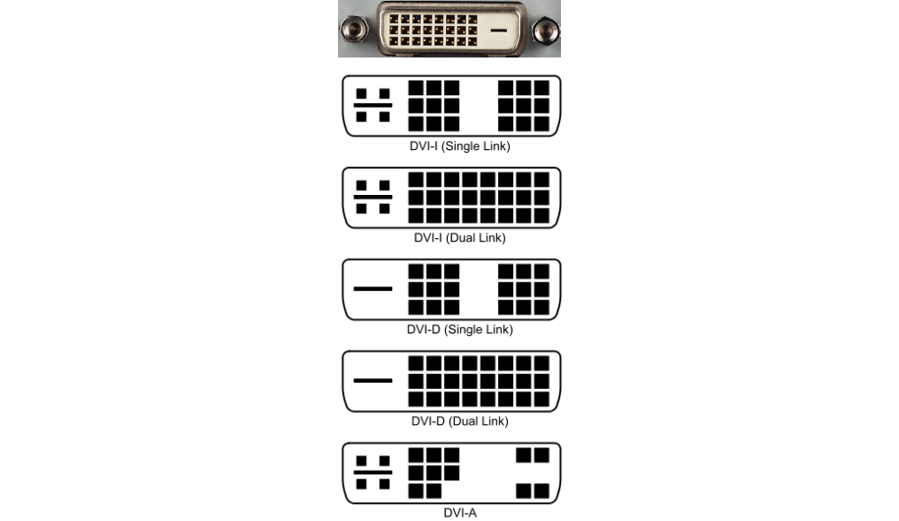
VGA and DVI
Video Graphics Array
  15-pin HD
  RGB component analog video
  Max resolution depends on cable quality
Digital Visual Interface (DVI)
  Single- or dual-link
  Analog (DVI-I / DVI-A) or digital (DVI-I / DVI-D) video signal
Unit 1.4 Connection Interfaces
Slide <number>

Slide 15
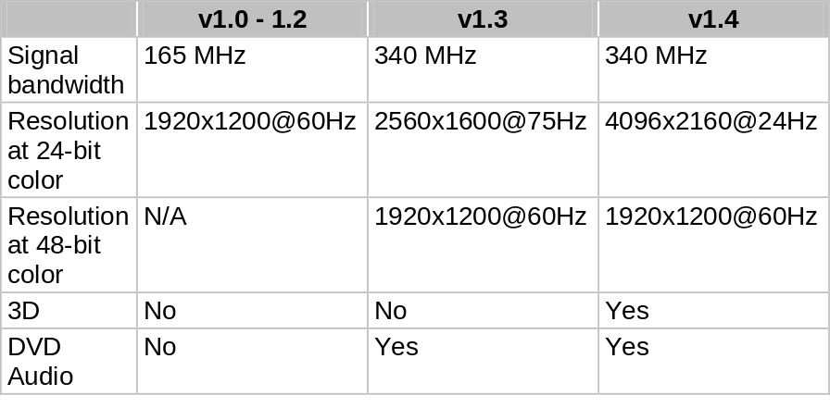
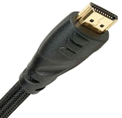
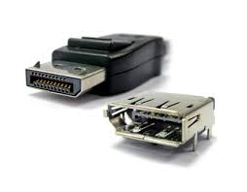
HDMI and DisplayPort
High Definition Multimedia Interface (HDMI)
  Digital-only
  Video + audio + remote control
  Multiple versions and bandwidth
  19-pin Type A connector
  Mini and micro types
DisplayPort
  VESA standard
  Complementary to HDMI
  20-pin connector
  DP++ ports compatible with HDMI and DVI
Unit 1.4 Connection Interfaces
Slide <number>

Slide 16
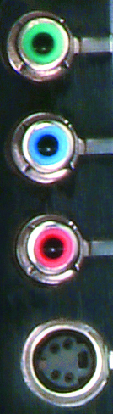
Other Display Ports
Composite
  Single RCA jack analog
S-video
  4-pin mini-DIN analog
  BNC with coax
Component (RGB)
  3-cable RCA analog or digital
Ethernet (RJ-45)
  Used for KVM (Keyboard, Video, Mouse) and CCTV
Unit 1.4 Connection Interfaces
Slide <number>

Slide 17
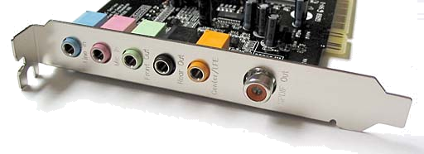
Audio Connectors
3.5mm / Tip Ring Sleeve
  Audio out (lime)
  Audio in (light blue)
  Headphones (black)
  Mic (pink)
S/PDIF (orange)
MIDI
Unit 1.4 Connection Interfaces
Slide <number>

Slide 18
Describe the functions and capabilities of connection interfaces (USB, SCSI, Firewire, Serial, Parallel, VGA, DVI, HDMI, and Audio)
Identify the types of cables and connectors used with connection interfaces
Unit 1.4 Connection Interfaces
Slide <number>

Slide 19
Lab 3 Identifying PC Ports
Unit 1.4 Connection Interfaces
Slide <number>

